Slide 1
HLP 7 Learning Module
Establish a Consistent, Organized, and Respectful Learning Environment
Ruby L. Owiny, Ph.D.
Minnesota State University, Mankato
Associate Professor of Special Education

Slide 2

REMINDER
Complete the Pre-Assessment on Google Forms before starting this video.

Slide 3

Module Objectives
As a result of this module, participants will be able to:
Explain the role of HLP 7 in creating conditions for learning.
Describe five key components of a consistent, organized, and responsive learning environment.
Identify evidence-supported practices that strengthen HLP 7 implementation.
Recognize common implementation challenges and select proactive solutions.
Use observable indicators to reflect on implementation and identify next steps.
Apply HLP 7 to analyze and improve a classroom learning environment.

Slide 4

HLP 7 Defined
To build and foster positive relationships with students, educators should establish age appropriate and culturally aware expectations, routines, and procedures within their classrooms that are positively stated and explicitly taught and practiced across the school year. When students demonstrate mastery and follow established rules and routines, educators should provide age-appropriate positive specific feedback in meaningful and caring ways. By establishing, following, and reinforcing expectations for all students within the classroom, educators will reduce the potential for challenging behavior and increase student engagement. When establishing responsive learning environments, educators should build mutually respectful relationships with students by demonstrating respect, cultural awareness, and accepting and valuing diverse learners.

Slide 5
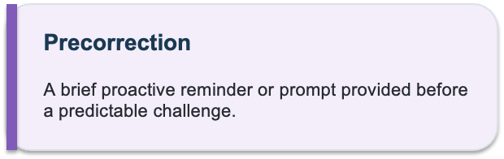
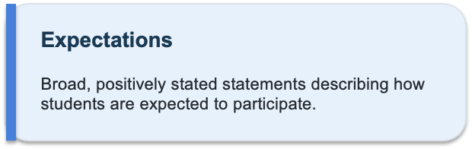
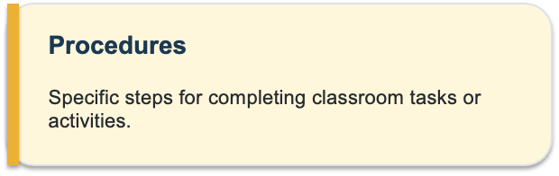
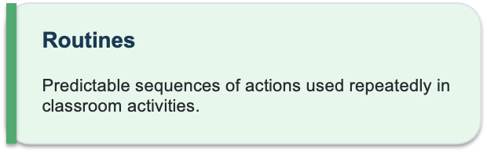
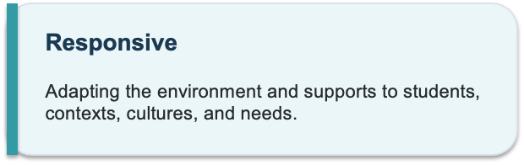
Definitions of Key Terms

Slide 6

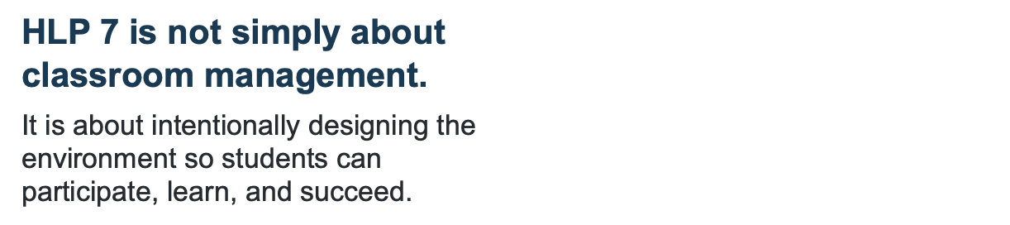
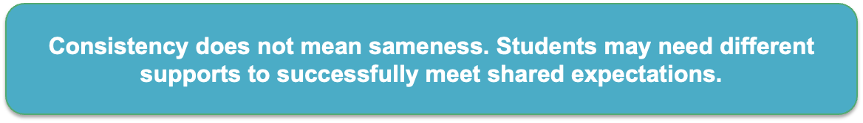
Significance of this HLP

Slide 7
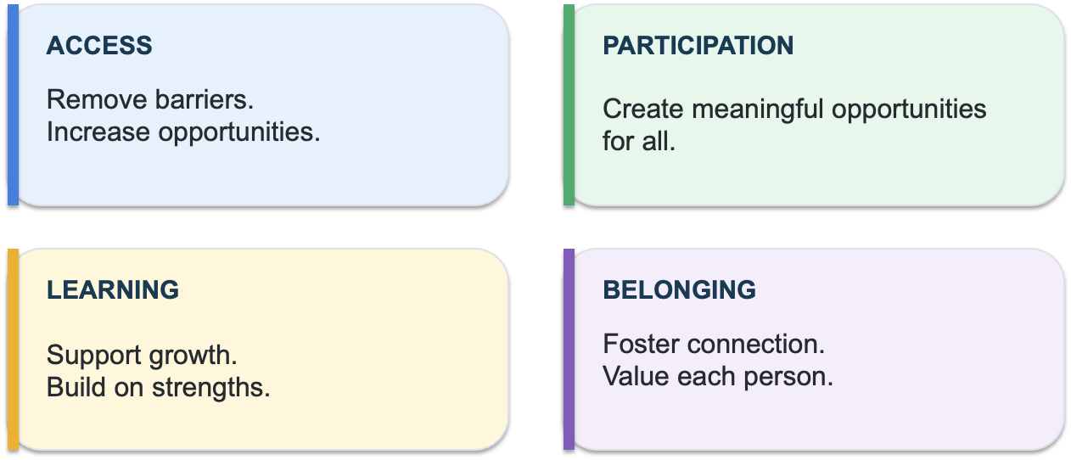
Significance of this HLP

Slide 8

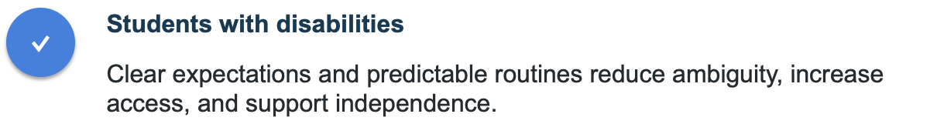
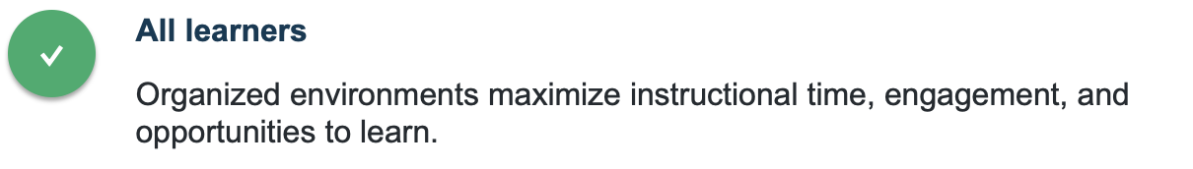

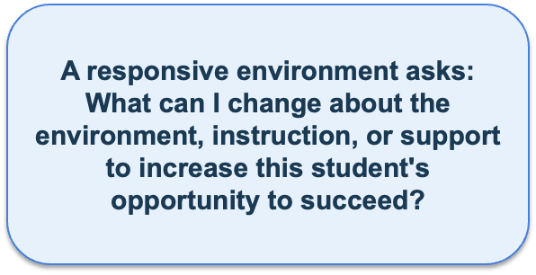
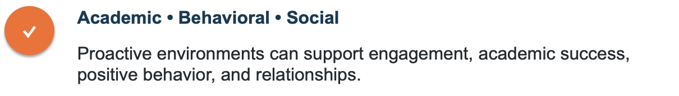
How this HLP Benefits Students

Slide 9
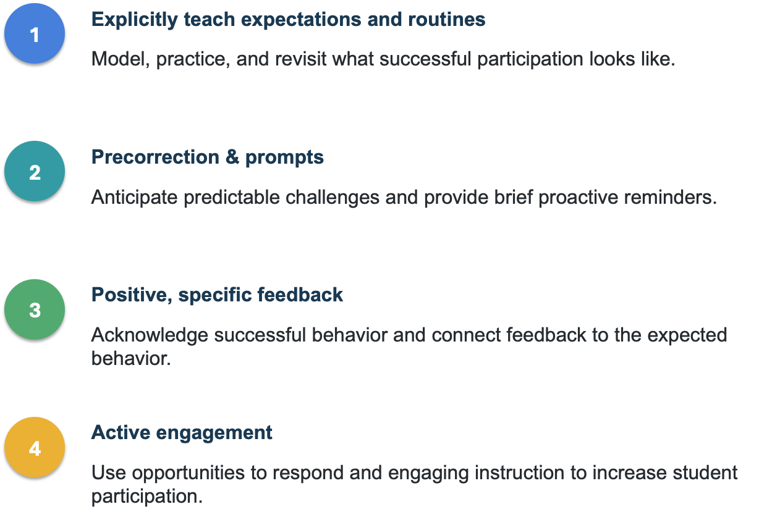

Evidence-Based Practices that Support HLP 7
Notes:
Make 2 slides for this, if needed

Slide 10
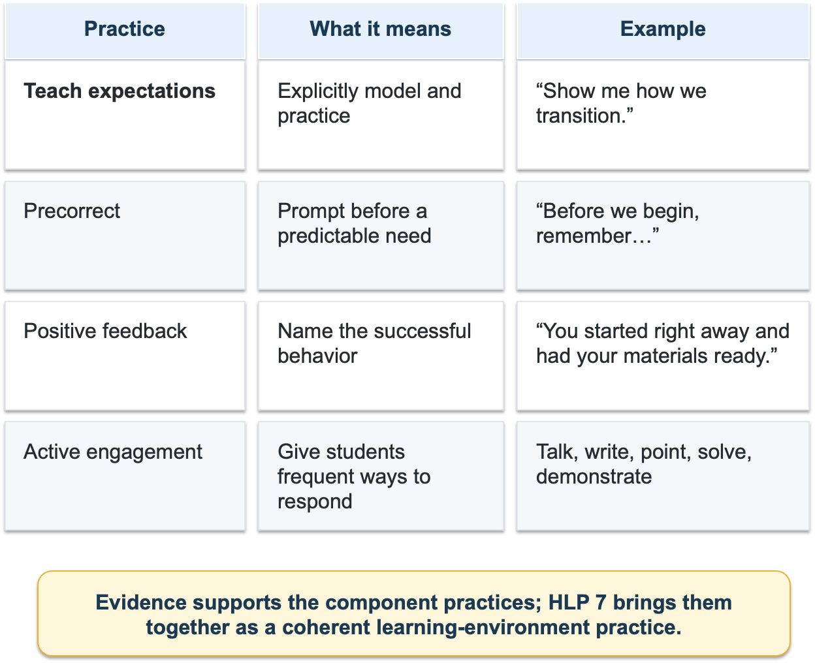
Evidence-Based Practices
that Support
HLP 7

Slide 11

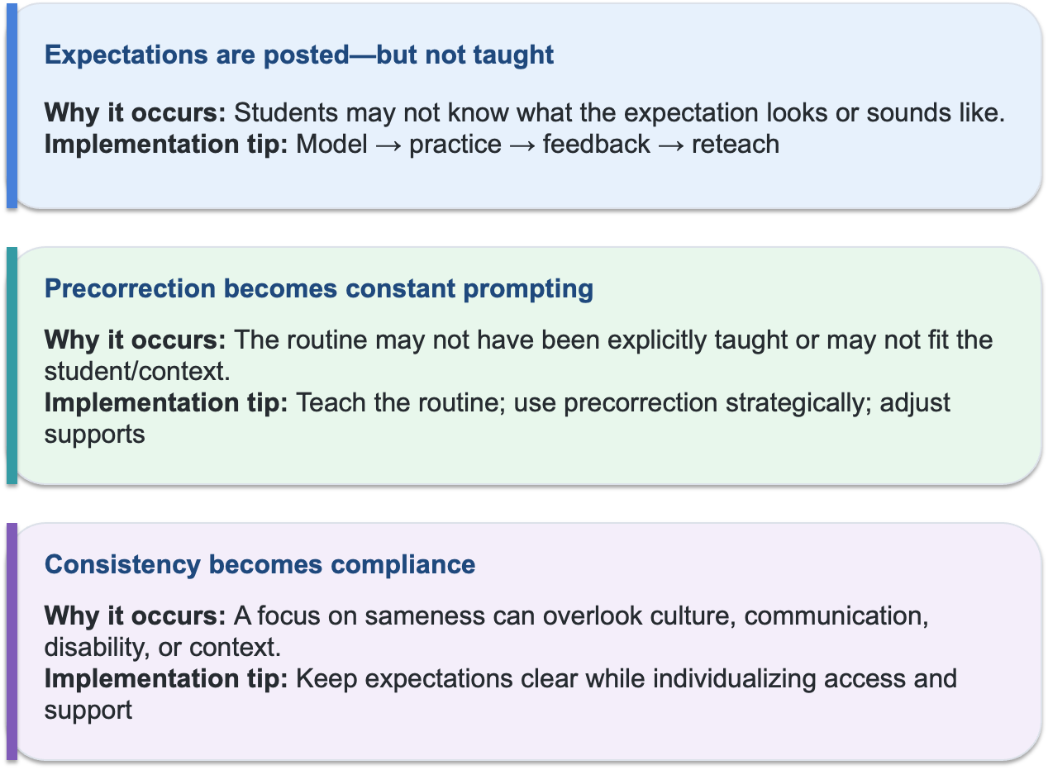
Common Challenges and Solutions

Slide 12
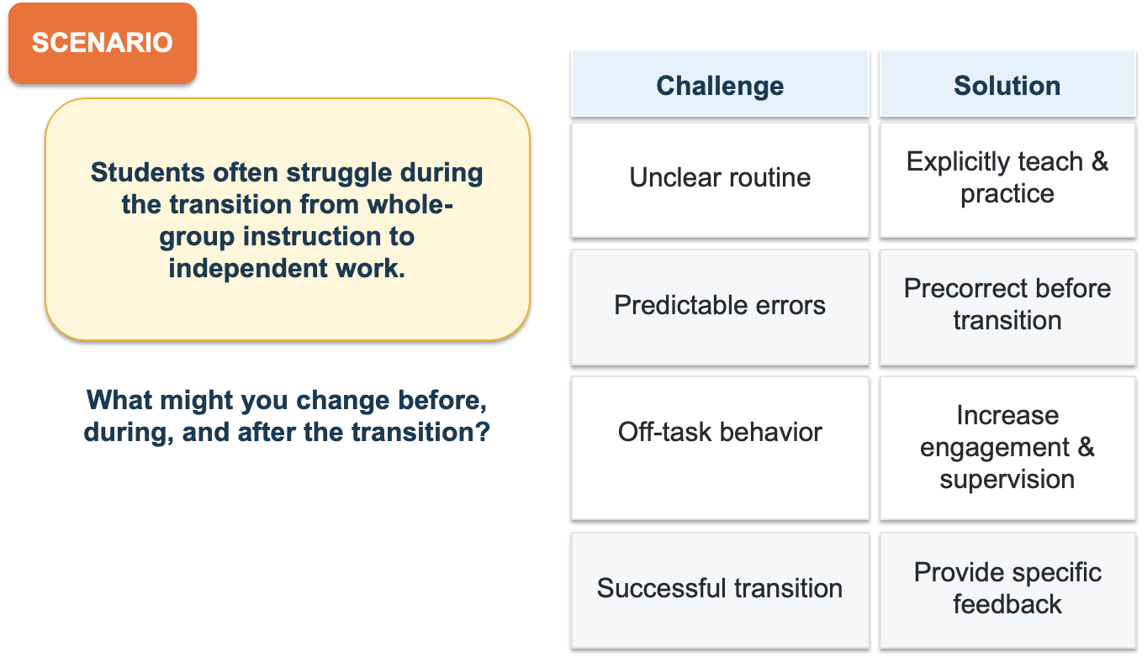
Common Challenges and Solutions

Slide 13
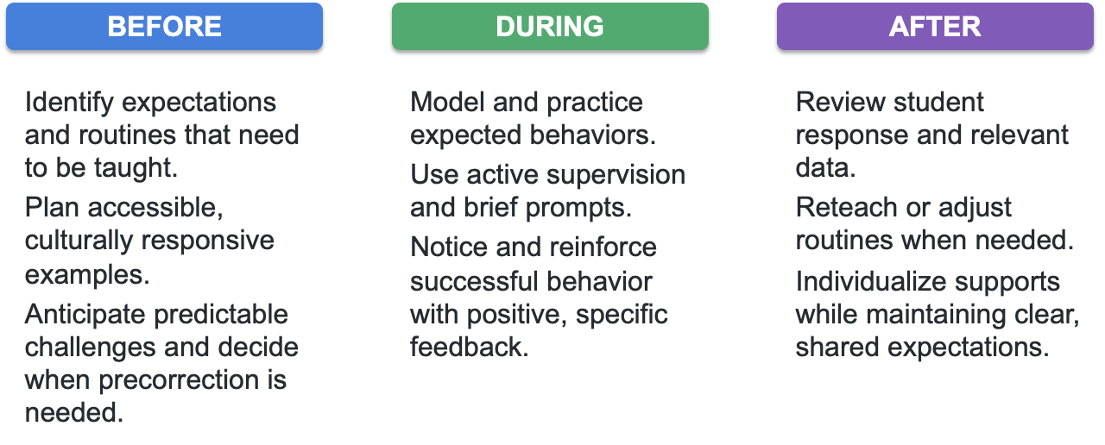
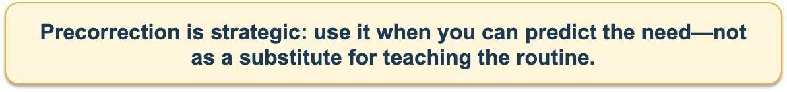
Implementation Tips
Notes:
This section should be highly practical.

Slide 14
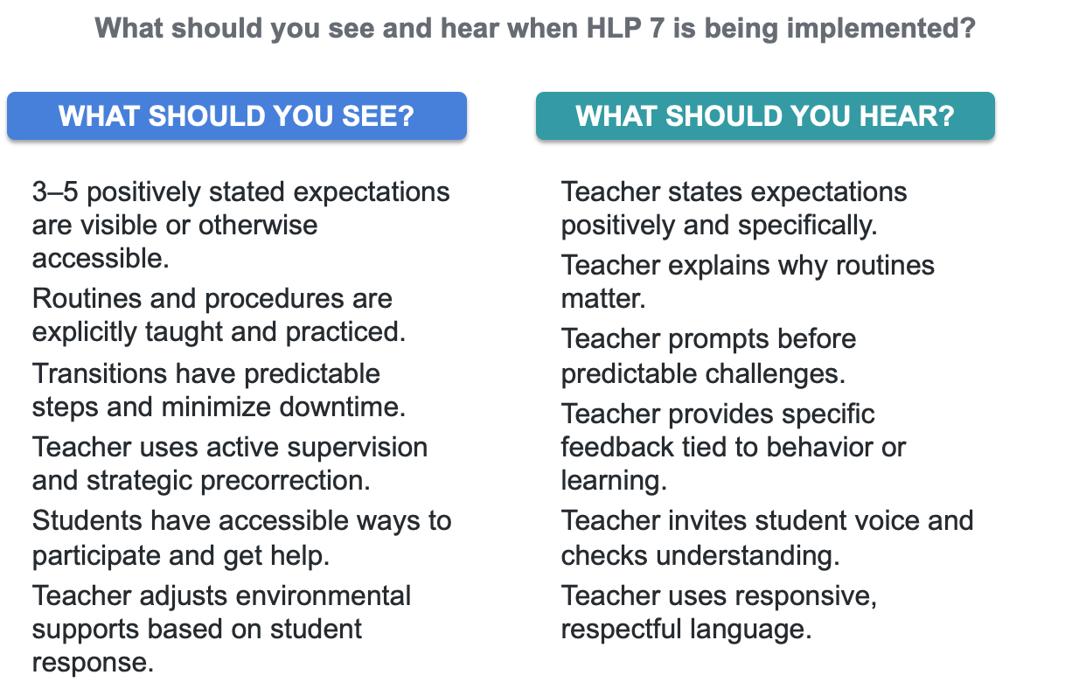
Observable
Indicators
Notes:
This section should be highly practical.

Slide 15
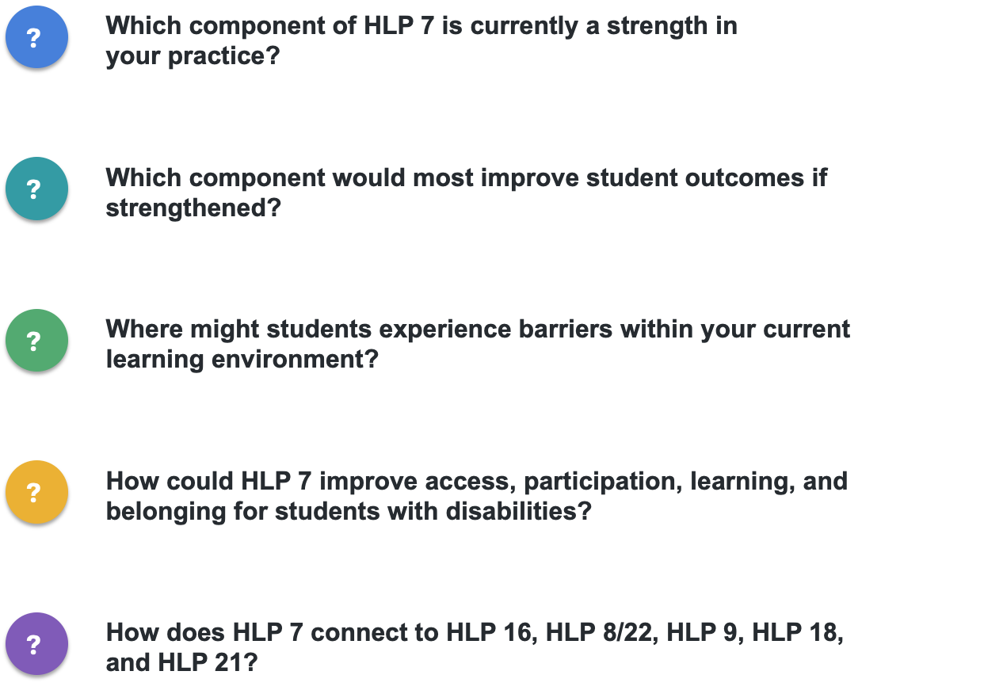

Questions to Consider
Notes:
This section should be highly practical.

Slide 16
References
Aceves, T. C., & Kennedy, M. J. (Eds.). (2024). High-leverage practices for students with disabilities (2nd
ed.). Council for Exceptional Children and CEEDAR Center.
Council for Exceptional Children. (n.d.). HLP 7: Establish a consistent, organized, and responsive learning
environment. Faculty implementation resources.
https://highleveragepractices.org/sites/default/files/2025-08/HLP%20Faculty%20Guides%202025%20
-%20HLP%207.pdf
Institute of Education Sciences, What Works Clearinghouse. (2024). Teacher-delivered behavioral
interventions in grades K–5. https://ies.ed.gov/ncee/wwc/practiceguide/31
Korpershoek, H., de Boer, H., & Mouw, J. M. (2026). An update of the meta-analysis of the effects of
classroom management interventions on students’ academic, behavioral, social-emotional, and motivational outcomes. Review of Educational Research, 96(5), 1640-1680. https://doi-org/10.3102/00346543251361903
Owiny, R. L., & Cornelius, K. E. (2024). The practical guide to high-leverage practices in special education:
The purposeful “how” to enhance classroom rigor. Routledge.
Simonsen, B., Putnam, R., Yaneck, K., Evanovich, L., Shaw, S. Shuttleton, C. Morris, K., & Mitchell, B.
(February, 2020). Supporting students with disabilities within a PBIS framework. Center on PBIS, University of Oregon. www.pbis.org.
Weinstein, C. S., Tomlinson-Clarke, S., & Curran, M. (2004). Toward a conception of culturally responsive
classroom management. Journal of Teacher Education, 55(1), 25-38.
https://doi-org/10.1177/0022487103259812

